Slide 1

Power point presentation - 30 min
Video– AAA- signs, signals, etc. - 20 min
Quiz- Signs, etc - 10 min
Correct, - 10 min
H/O- Signs, - 10 min
Correct H/O, - 10 min
Lesson Plan Day 2

Slide 2
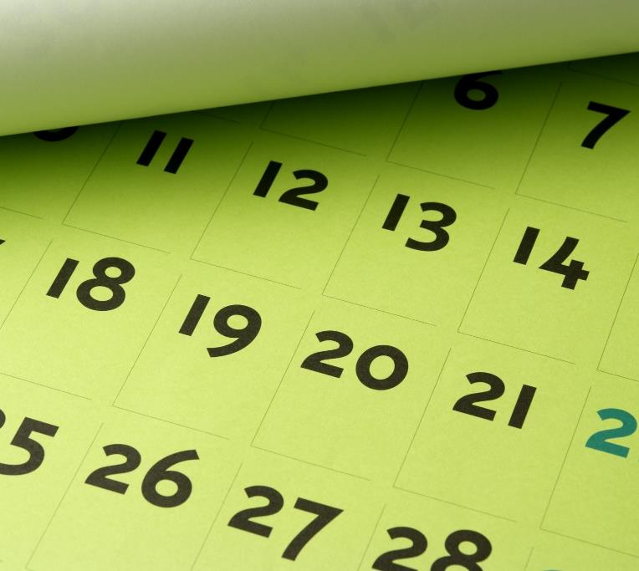
Day 2 Chapter 2
Objectives
1- State the meaning of the eight shapes and eight colors used for traffic signs
2-Describe the actions to take at Stop, Yield, and Speed limit signs
3-Explain how guide signs and international signs help you when driving
4-Explain what to do at a green light, a yellow light, and a red light
5-Describe the action to take when you approach a flashing red signal or a flashing yellow signal
6-Describe the actions to take with pedestrian signals and traffic control officers signals.
7- Describe the difference between broken yellow lines and broken white lines
8-Explain the differences between a shared left-turn lane and a left-turn lane.

Slide 3
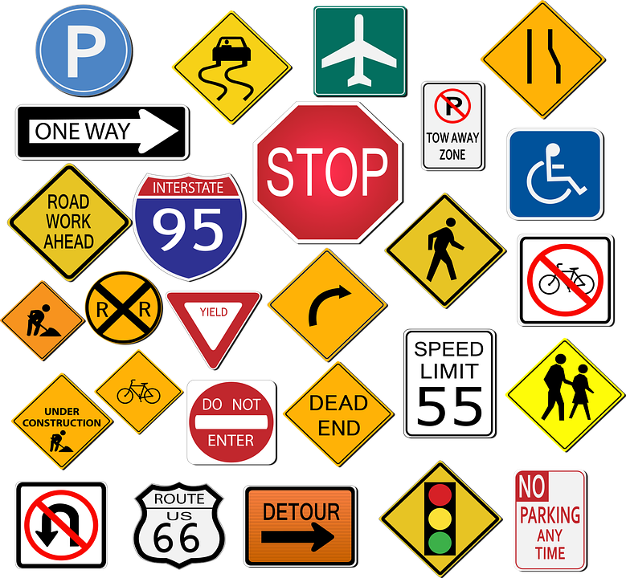
Traffic signs serve many purposes, each traffic sign has a specific shape and color.
Each sign shape and color has a special meaning. By knowing the meanings of these shapes and colors, you can get valuable information form a sign.

Slide 4
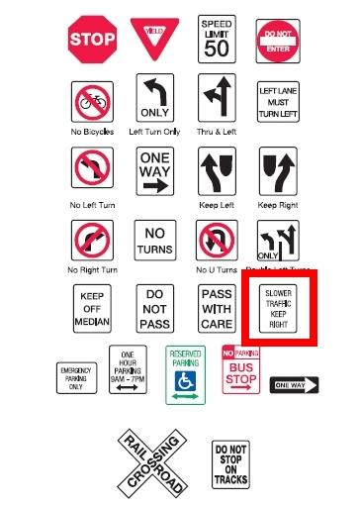
Regulatory Signs
Control movement and flow of traffic
Regulatory signs tell you about laws that you must obey.
The most important signs, Stop and Yield, have unique shapes.
All other regulatory signs are either white squares or rectangles with red or black lettering.

Slide 5
Warning Signs
(Usually Diamond Shaped)
Warning signs will alert you to possible hazards and road conditions.

Slide 6
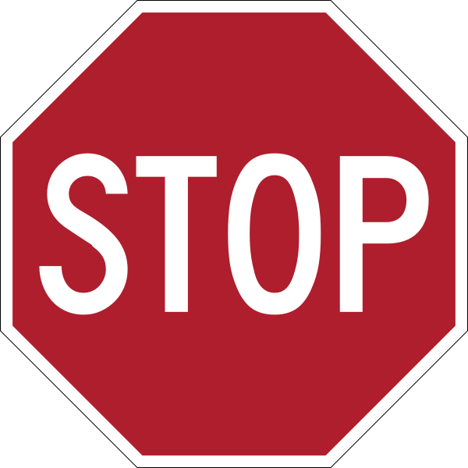
Stop Signs
Always come to a complete stop
Once stopped, you must yield the right of way to pedestrians or other vehicles in or approaching the intersection.
At some intersections, Stop signs are posted at all four corners. Each stop sign might include a small sign that says “4 way” or “All Way” follow these steps at a 4-way stop:

Slide 7
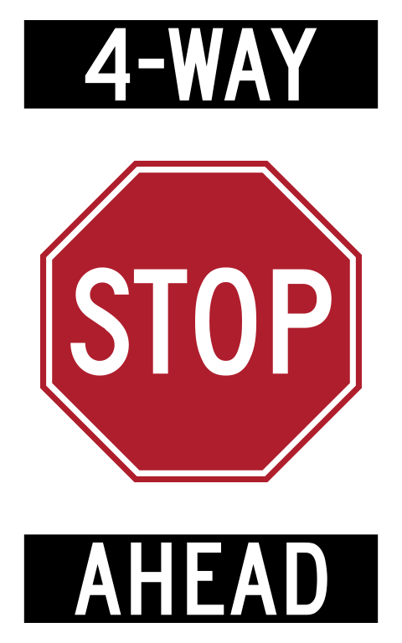
1- The driver who stopped first should be allowed to go first.
2- When vehicles stop to the right or left or each other at the same time, the driver on the left should yield to the driver on the right
3- When stopped across the intersection facing oncoming traffic, the driver going straight should be allowed to proceed. A driver turning left should wait.
4- Show your intention to proceed by moving forward slowly before entering the intersection.
5- Check for traffic ahead and to the sides before entering the intersection.

Slide 8
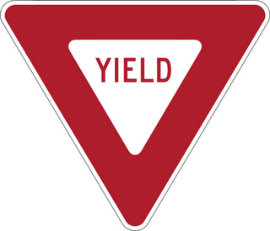
Yield Signs
Slow down as you approach the intersection
Prepare to stop and yield the right-of-way to vehicles and pedestrians in or approaching the intersection.
You must come to a complete stop at a yield sign if traffic conditions require it.

Slide 9
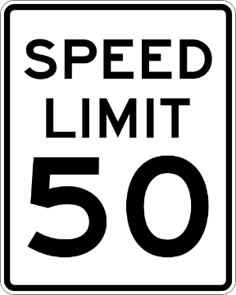
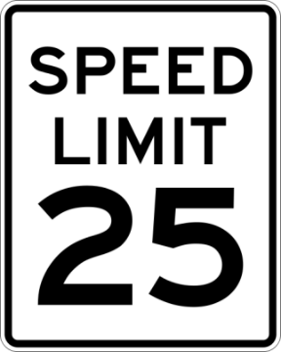
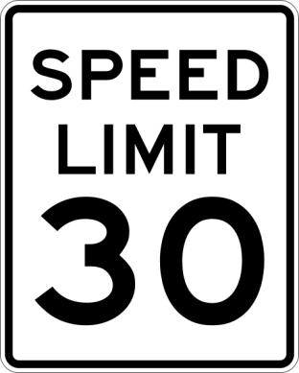
Speed Limit
Signs
Speed limit signs are used to manage traffic flow at safe speeds.
When traffic, roadway, or weather conditions are not ideal, you must obey the Basic Speed Law.
This law states that you many not drive faster than is safe and prudent for existing conditions, regardless of posted speed limits.

Slide 10
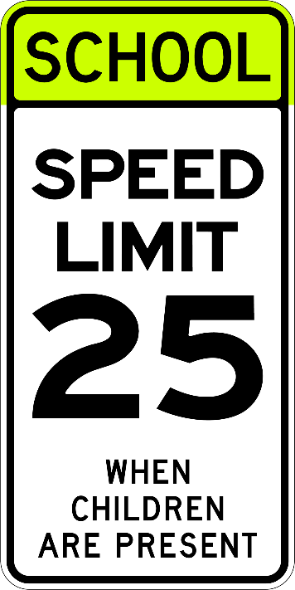
Special Speed Signs
Minimum Speed Limits are set on some roadway ways to keep traffic moving safely.
Advisory Speed Limits are set for special conditions such as sharp curves.
Special Speed Limits are set for different times of the day. For example, school zones have special speed limits when children are present or during school hours. Night driving speed limits may be lower than daylight limits.

Slide 11
Regulatory Signs
Regulatory traffic signs are white with black or red letters instructing road users what they must or must not do under certain conditions.
Regulatory signs indicate and reinforce traffic laws and regulations which apply either permanently or at specified times or places.
Direct traffic to turn or go straight
Direct one-way traffic
Control parking & passing

Slide 12
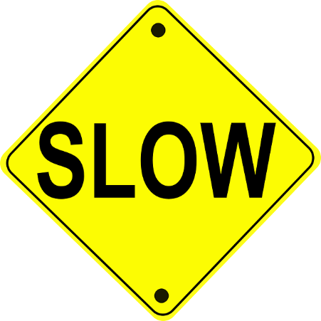
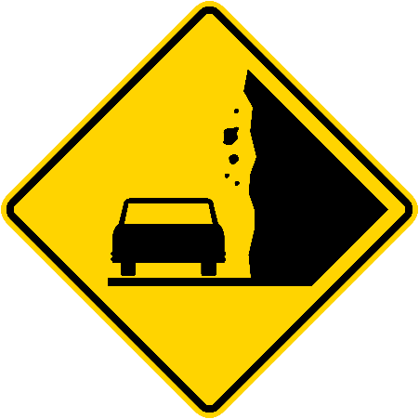
Warning Signs
Warning signs have black symbols or lettering on a yellow background.
A warning sign can help you avoid surprise situations.
Most warning signs are diamond-shaped.

Slide 13
School Zone Signs
A school zone is portions or a street or highway near a school that is subject to special speed limits.

Slide 14
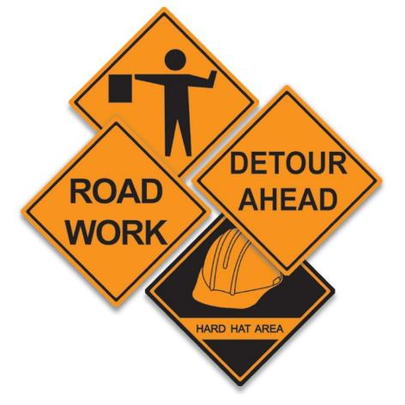
Construction Signs
A construction sign acts as an expression of notification through the application of physical, identifiable, and textual displays designating the required adherence to standards and practices within the perimeters of a construction zone.
Orange in color, generally in a diamond or rectangular shape.
Orange, triangular warning signs might be used on a construction vehicle to warn that the vehicle is slow-moving.

Slide 15
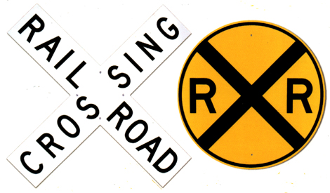
Railroad Signs
These marking warn you to be aware of the crossing ahead and to pay particular attention to the possible approach of a train.
A round, yellow sign with a black “X” and “RR” warns of a railroad crossing ahead.
This sign is posted 250 feet before a railroad crossing in an urban area.

Slide 16
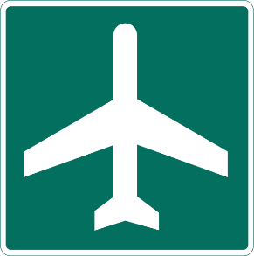
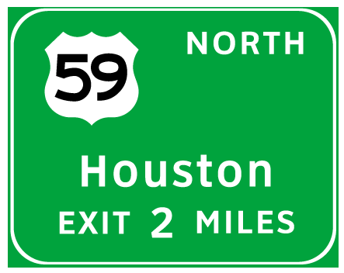
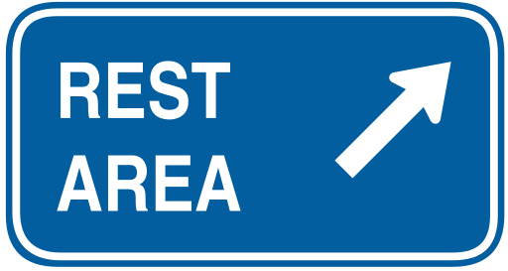
Guide Signs
A guide sign provides a variety of information.
Routes
Intersections
Service Areas
Information
Points of interest

Slide 17
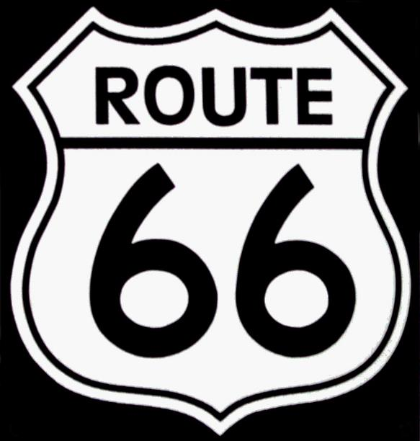
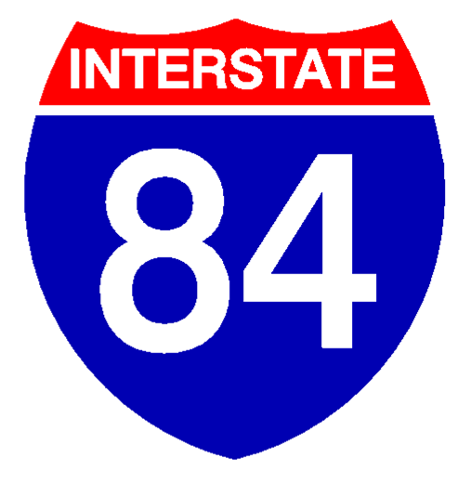
Route Signs
A highway shield or route marker is a sign denoting the route number of a highway, usually in the form of a symbolic shape with the route number enclosed.
As the focus of the sign, the route number is usually the sign’s largest element, with other items on the sign rendered in smaller sizes or contrasting colors.
Local, state, U.S., and interstate routes are posted with route signs.

Slide 18
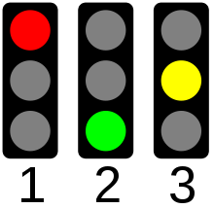
All traffic signals have specific colors.
Red means stop.
Green means go: proceed if the way is clear and safe.
Yellow means caution: be ready to stop.
Traffic Signal
Traffic signals are used to help traffic flow smoothly.
Traffic Lights
Arrows
Flashing Signals
Lane Signals
Pedestrian Signals

Slide 19
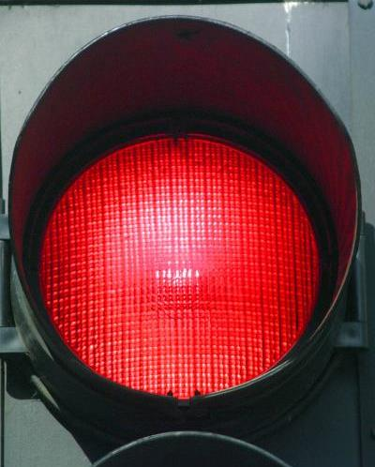
Red Light
You must come to a complete stop.
Stop behind the stop line, crosswalk, or before entering the intersection if no stop lines are used.
You can make a right turn on red light if you come to a complete stop and look for the intersection to be clear, remember to look for cross traffic.

Slide 20
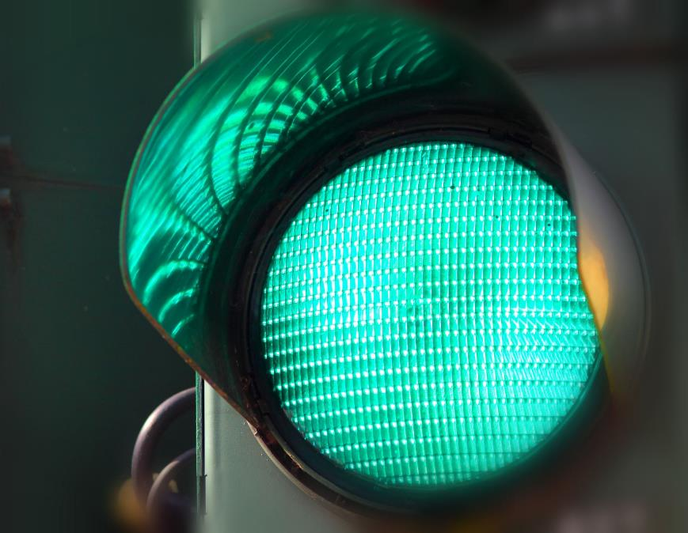
When approaching a green light, check traffic to the left, front, and right before entering the intersection.
When approaching a light that has been green for some time, be prepared for the light to turn yellow.
Proceed only if the intersection is clear.
The green light will be mounted at the bottom or to the right on the traffic signal.
Green Light

Slide 21
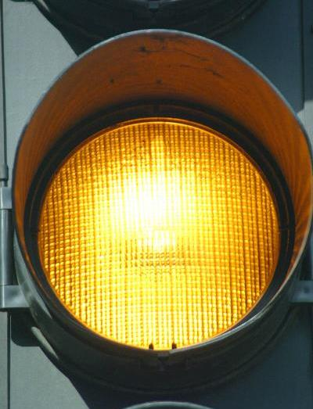
Yellow Light
Make ever effort to stop safely for a yellow light. Sometimes you might be too close to stop safely when a yellow light appears.
You then will have to proceed with caution.
The yellow light will appear in the center on the traffic signal.

Slide 22

Flashing Signals
A flashing signal alerts drivers to dangerous conditions or tells them to stop.
Flashing Red: Come to complete stop and treat like a four-way intersection
Flashing Yellow: Slow down, be prepared to stop if necessary.

Slide 23
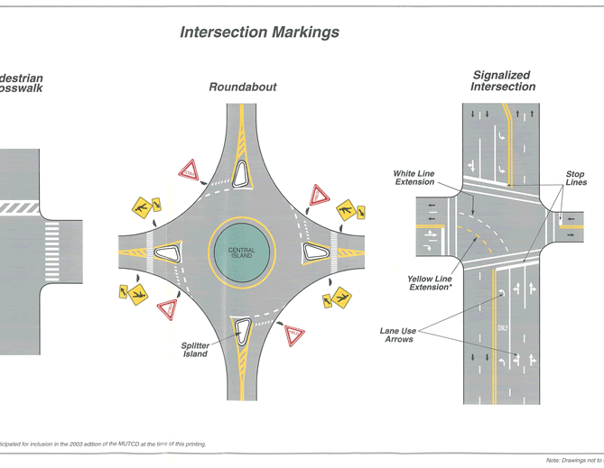
Roadway marking gives you a warning or direction.
These markings are usually lines, words, or arrows painted yellow or white on the roadway.
Sometimes special marking are used on curbs and other surfaces.
Roadway Marking

Slide 24
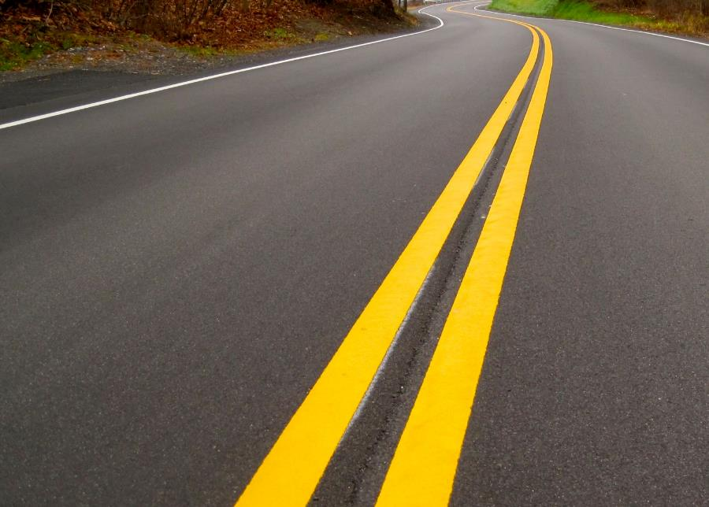
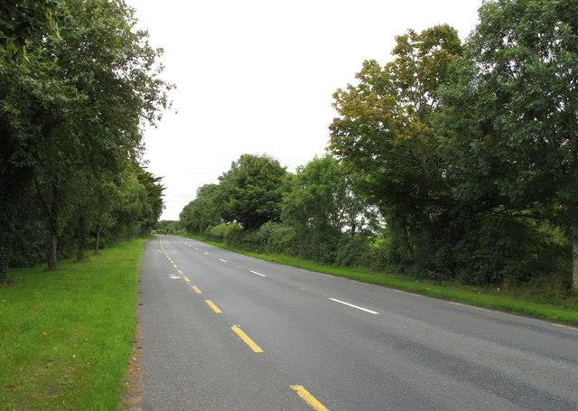
A solid yellow line on the driver’s side of the center line indicates that passing is not allowed.
A broken yellow line separates two-way traffic. It also means a driver may pass only when no traffic is coming from the opposite direction.
Turning left across a solid yellow line into a driveway or alley is allowed after yielding to oncoming traffic.
Yellow Line Marking

Slide 25
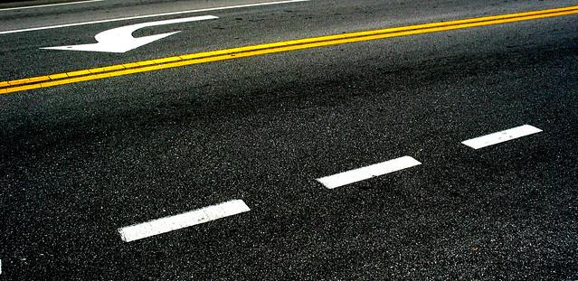
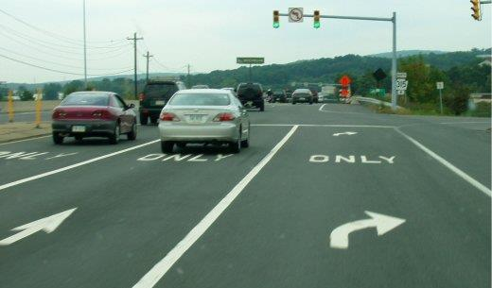
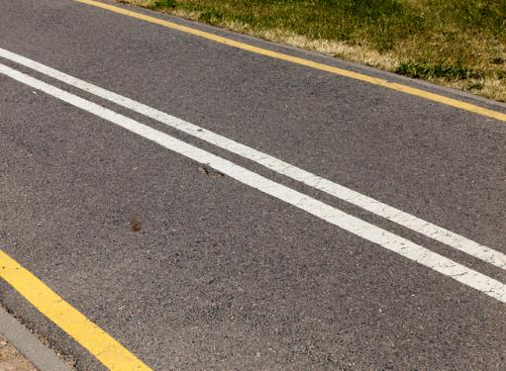
White Line Markings
Broken white lines separate lanes of traffic that are moving in the same direction. You may cross these broken white lines when changing lanes.
Solid white lines indicate that you should not cross them.
White arrows are painted in lanes to tell you when and where to turn. If you are in a lane with an arrow and the word ONLY, you must continue In the direction of the arrow.
Solid white lines are also used to mark pedestrian crosswalks and stop lines.
A special white marking on the roadway is used to show you where an exit ramp starts.

