Slide 1
Lesson Plan Day 4
Driver’s education notes:
Steering straight backward, Changing lanes, Hand over hand steering, Push Pull steering, Procedures for turning, Backing left and Right, U turns, Pulling into driveway, 3-point turns, Angle Parking, 90-degree parking, parallel parking, uphill and downhill parking, searching an intersection.
Video’s- Safety tips, Road Rage, Handling vehicle malfunctions.
H/O- Chapter 7
Correct chapter 7 handout
101 safe driving tips 11-101

Slide 2
Day 4 Objectives
Explain how to search an intersection after it has been identified
Tell when you are at the point of no return
Describe what you should do when you have a closed front zone at an intersection

Slide 3
Explain how to approach a controlled intersection
Tell how to move from a STOP sign when our view is blocked
Describe how to make right turns and left turns at controlled intersections.
Tell how to identify an uncontrolled intersection
Explain the procedures to follow at an uncontrolled intersection.
Describe the proper procedures for crossing uncontrolled railroad tracks.
Define right of way
Describe situations in which you, the driver, must yield the right of way
Identify how long it takes to cross and join traffic

Slide 4
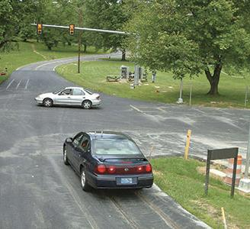
The chances of a collision are greater at intersections than at any other point on a roadway
More than one-third of all collisions and one-fourth of all fatal collisions take place at intersections

Slide 5
Identifying a Safe Path of Travel
In order to identify a safe path of travel you first need to locate the intersection
Look for these clues to identify an intersection ahead:
Street Signs & Streetlights
Roadway Marking
Crossing Traffic
Parked Vehicles on Cross Streets
Turning Traffic
Fences & Mailboxes
Traffic Stopping
Power Lines

Slide 6
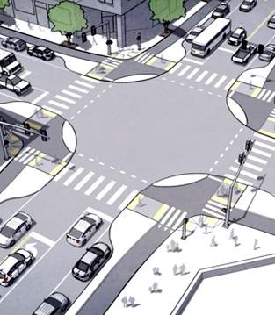
Approaching an
Intersection
After identifying an intersection, you will need to determine if you have an open zone for your intended path of travel into and through the intersection.
Search the left front, front, and right-front zones to be certain that they are open.
Look for line-of-site restrictions that will prevent you from seeing if your intended path of travel is going to be safe.

Slide 7
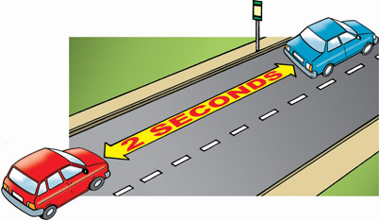
The point-of-no-return is the point beyond which you can no longer stop safely without entering the intersection. Under normal conditions, that point is two seconds from the intersection.
Point of No Return

Slide 8
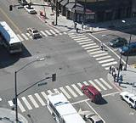
You are not allowed to make lane changes within an intersection. You should select the best path of travel before entering an intersection.
Navigating
An
Intersection

Slide 9
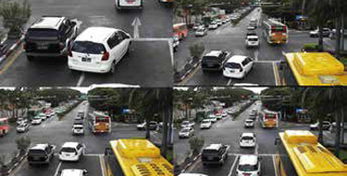
YOU ARE NOT ALLOWED TO MAKE A LANE CHANGE WITHIN AN INTERSECTION YOU SHOULD SELECT THE BEST PATH OF TRAVEL BEFORE ENTERING AN INTERSECTION
CROSSING
AN
INERSECTION

Slide 10
Moving After a Stop
After you have stopped and your front zone is clear, search at 90-degree angles to the right and left before you begin moving.
When turning, your last check should be in the direction of your intended path of travel.
You need to know if your intended path of travel is open before you enter an intersection.
If you are stopped behind another vehicle, wait one second after it begins to move before you move.
This gives you room to respond to any sudden stop made by the vehicle ahead.

Slide 11
A controlled intersection is one at which traffic signals or signs determine the right of way.
Obey all signs and traffic signals when you approach a controlled intersection.
Yield the right of way to through traffic
Controlled Intersection

Slide 12
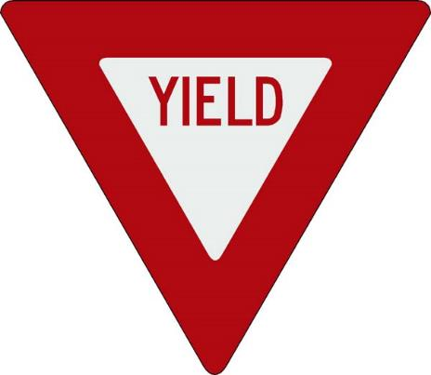
Controlled Intersection With Signs
Two kinds of signs control intersections:
Stop Sign: You must come to a complete stop.
Yield sign: slow and yield the right of way to vehicles on the through street.

Slide 13
Controlled Intersections With Signals
Traffic signals usually have three lights to each cycle
Red
Yellow
Green
Signals also can have a fourth or fifth light, such as a yellow arrow and a green arrow.

Slide 14
As you drive toward a controlled intersection with a signal, consider if the signal is about to change.
Treat each intersection as a separate problem.
Searching 12-15 seconds ahead, evaluate the next intersection to see what color that light is.
Look for any traffic moving on the cross street.
Note: Always check your rear zone when coming to a stop.
Approaching a
Controlled Intersection

Slide 15
Uncontrolled Intersection
An uncontrolled intersection has no signs or signals to regulate traffic.
Predict that other traffic will not stop, Reduce speed, search aggressively, and always be prepared to stop

Slide 16
Avoiding Conflicts at an Intersection
A safe driver knows that conflicts often occur at intersections and is prepared to handle these conflicts.
To be a safe driver, you need to know when to yield the right of way

Slide 17
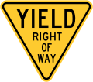
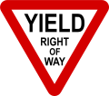
Right of Way
The term right of way describes the privilege of having immediate use of a certain part of a roadway.

