Slide 1
Day 6 Lesson Plan
Power Point
Drunk Walk (glasses)
Video Drug and Alcohol Awareness
Chapter 15 Handout
Correct Handout
Funny Signs, and Car Crashes
60 Minutes Video
Dancing Cowboy Clip

Slide 2
Day 6
Objectives
Explain how alcohol affects mental and physical abilities needed for driving
Define blood alcohol concentration
Explain factors that affect blood alcohol concentration
List five myths and truths about the use of alcohol
Explain the difference between the purchase of over the counter medicine and the purchase of prescription medicine
Explain how depressants, stimulants, and hallucinogenic drugs can affect a driver.
Describe the effects of combining alcohol with other drugs.
Explain what is meant by the implied consent law
Describe zero tolerance levels of intoxication, and tell how these levels can be measured
Explain what a driver should do when stopped by a police officer

Slide 3
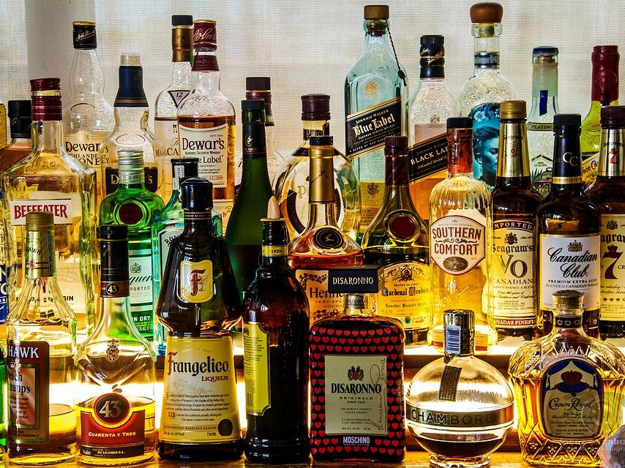
Effects of alcohol on driving safely
Alcohol is the most commonly used drug in our society today. It is by far the most frequently found drug in fatally injured drivers.

Slide 4
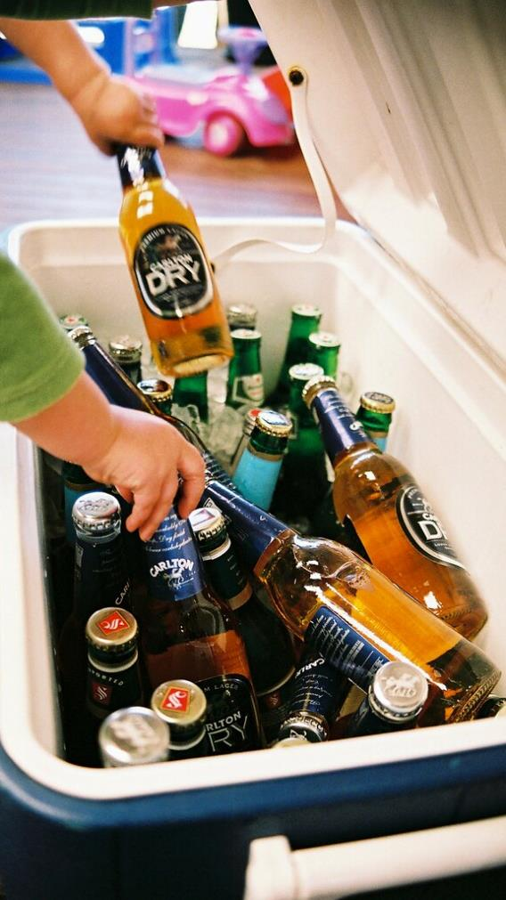
Facts About Alcohol & Driving
Young drunk drivers are involved in fatal crashes at twice the rate of drivers aged 21 and older
Drivers aged 16 through 20 are more likely to be alcohol impaired than any other age group
Nearly half of those killed in alcohol related collisions had not been drinking but were victims of drunk drivers
More than half of all fatalities during holidays are alcohol related
Half the students in this classroom will have a DUI on their record before their driving career is finished.

Slide 5
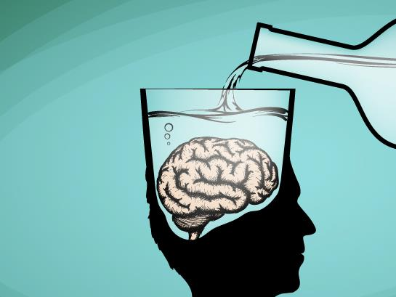
Effects of Alcohol
Once alcohol enters the bloodstream, it quickly flows to the brain. Alcohol has the greatest effect on the parts of the brain that control judgment and reasoning, the two most critical mental skills needed by drivers.

Slide 6
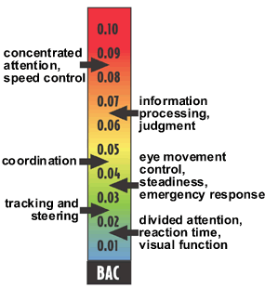
Alcohol in the Body
The amount of alcohol in the blood is called blood alcohol concentration (BAC)
What is the legal BAC for those of you taking this class?

Slide 7
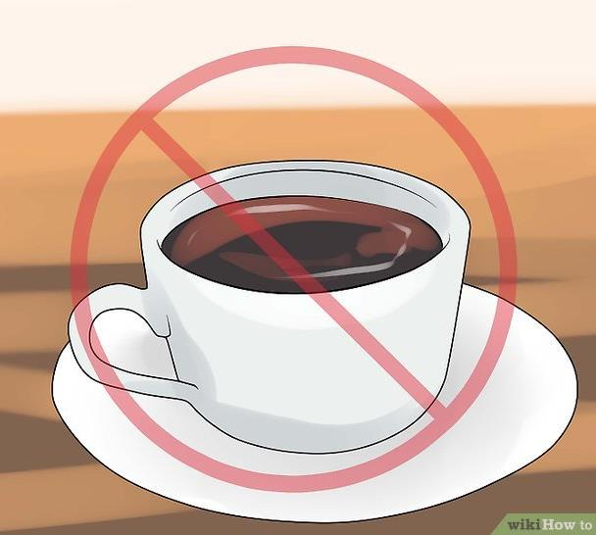
Myths and Truths about Alcohol
Myth:
I can sober up by drinking black coffee, taking a cold shower, or doing exercise.
The truth is that these activities do not reduce the BAC. The person may seem more alert, but the BAC is not reduced

Slide 8
Myths and Truths about Alcohol
Myth: One little drink won’t hurt me
The truth is impairment starts with the first drink.

Slide 9
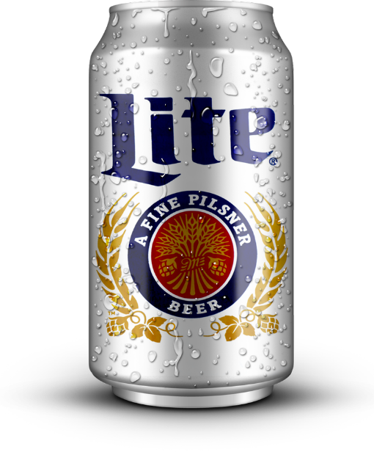
Myths and Truths about Alcohol
Myth:
I will not be affected because I am only drinking beer
The truth is that a 12- ounce can of beer contains as much alcohol as an average cocktail

Slide 10
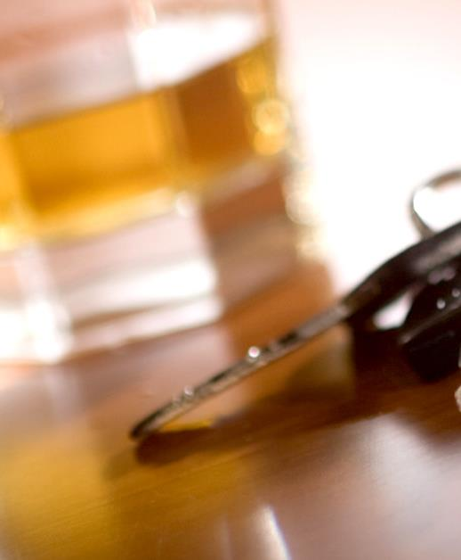
Myths and Truths about Alcohol
Myth:
I can drive better after a few drinks
The truth is that your driving abilities are diminished, not improved

Slide 11
Myths and Truths about Alcohol
Myth:
A young person cannot become a problem drinker
The truth is that some young people become problem drinkers even as teens

Slide 12
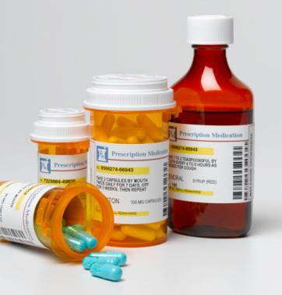
Other Drugs and Driving
Besides alcohol, there are many other types of drugs that are both legal and illegal.
When used properly, most legal drugs have a positive effect. However, even medicines designed for good can cause hazardous driving situations.

Slide 13
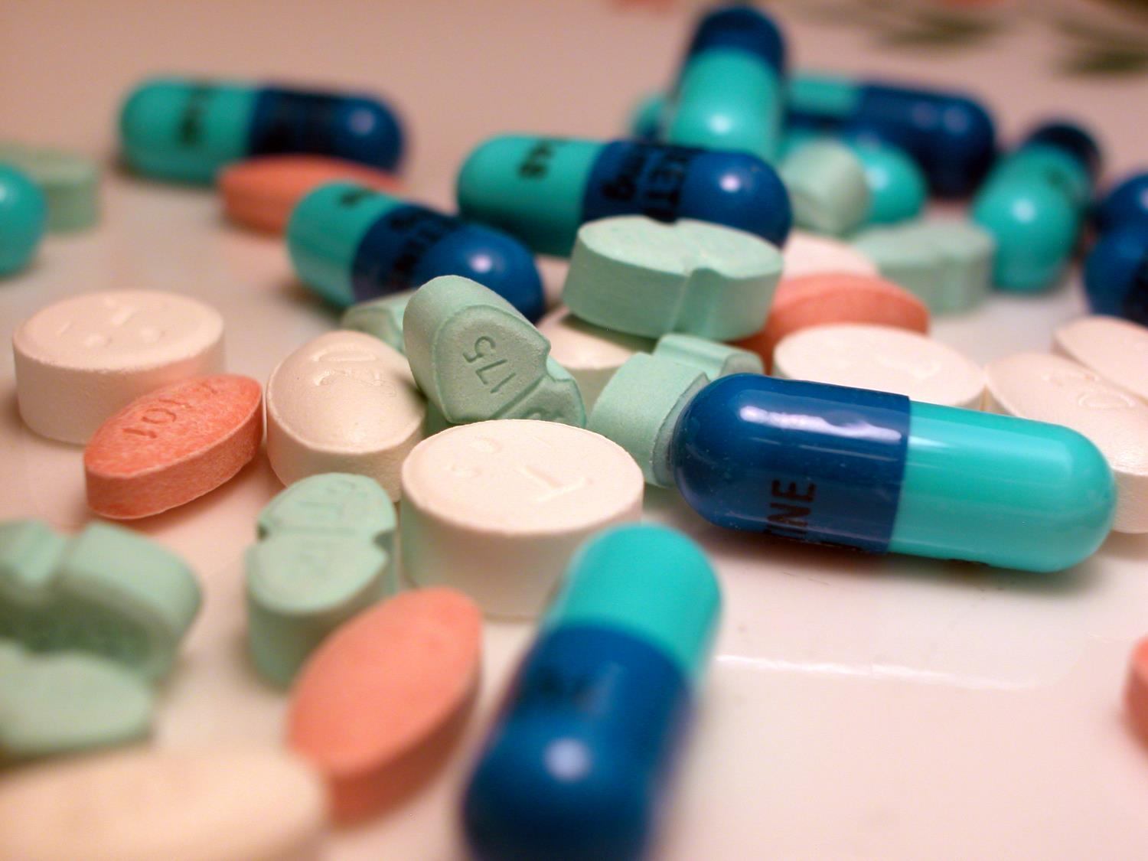
Types of Drugs
Over the counter medicines
Prescription Medicines
Depressants
Stimulants
Hallucinogens

Slide 14
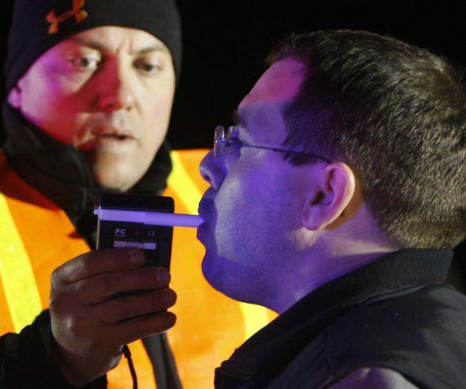
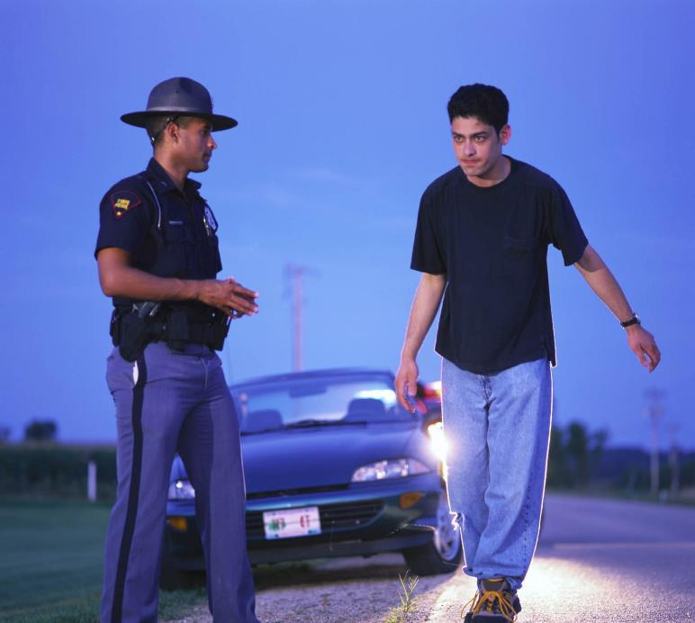
Traffic Laws Governing the Use of Alcohol
Implied Consent Law:
Every state has an implied consent law for drivers. Implied consent means that anyone who receives a driver’s license automatically consents to be tested for BAC and other drugs if stopped for suspicion of drug use while driving.
If driver does not cooperate with the officer and refused to be tested for BAC, that driver’s license can be suspended

Slide 15
Because there is no “safe” amount of alcohol for drivers, all states have set a BAC level at which drivers could be charged with driving while intoxicated
Many states, a charge of DWI can be made if the driver’s BAC is .05
What is the set BAC level in Utah?

Slide 16
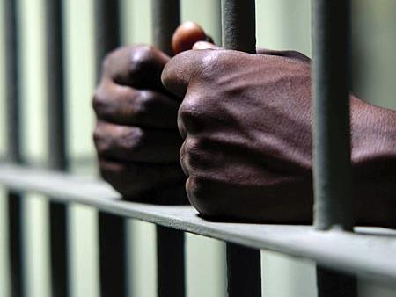
Penalties for conviction
Suspension or revocation of driver’s license
Payment of a fine
Serving a prison term

Slide 17
Zero Tolerance Law
A zero-tolerance law makes it illegal for persons under the age of 21 to drive with any measurable amount of alcohol in the blood.

Slide 18
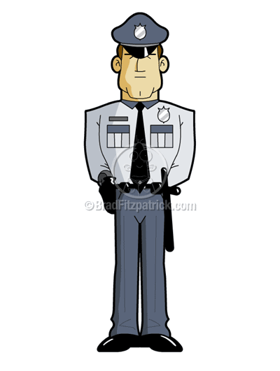
If You Are Stopped by a Police Officer
Pull over to the right and stop in a safe place.
You might need to pull into a parking lot or a side street to be out of the way of moving traffic
Keep your hands visible as the officer approaches
Stay in your vehicle and follow the instructions the officer gives you.
You will be required to show your driver’s license, and certificate of insurance.

