Slide 1
Day 7 Lesson Plan
Power Point Day 7
First Aid Booklet: What two do in emergencies, and what to do until the ambulance arrives.
Review techniques on what to do when involved or see an accident
Video: What to do in an emergency
Video: Driving in hazardous conditions
Chapter 5 Handout & Handout on emergency situations or first aid techniques
Correct Handouts: Chapter 5 and first aid techniques
Use scare tactic: How fast must you be going to do this.

Slide 2
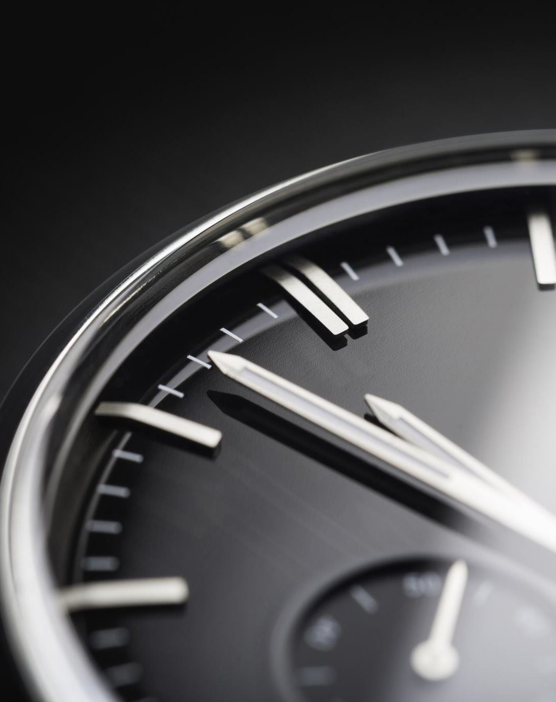
Day 7
Objectives
Explain how gravity affects your car
Describe the factors that affect energy of motion
Explain how traction controls your car
List three things that can reduce traction
List factors that affect your car in a curve
Define total stopping distance
Explain how to use the four second rule
Name four factors that affect braking distance
List three factors that will change your vehicle’s force of impact in a collision
Explain the correct way to adjust safety belts
Describe how a driver and passengers should position themselves to benefit from air bags
Explain how to best position and use child safety seats.

Slide 3
Gravity and energy of motion are natural laws that will affect the way your vehicle performs.
When you operate a light vehicle like a bicycle at low speeds, you can easily maintain control.
Control can be tricky, however, when you drive a car or a light truck that weighs almost two tons.
In emergency situations, natural laws can create forces that can work for or against you
Gravity and Energy of Motion

Slide 4
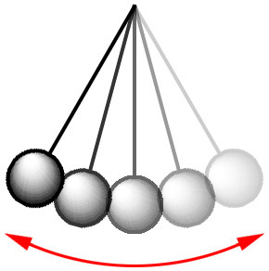
Energy of Motion
When an object moves, it acquires energy. This force is called energy of motion, or kinetic energy.
The faster your vehicle moves, the more energy of motion it has.
Energy of motion is also affected by the weight of the moving object.

Slide 5
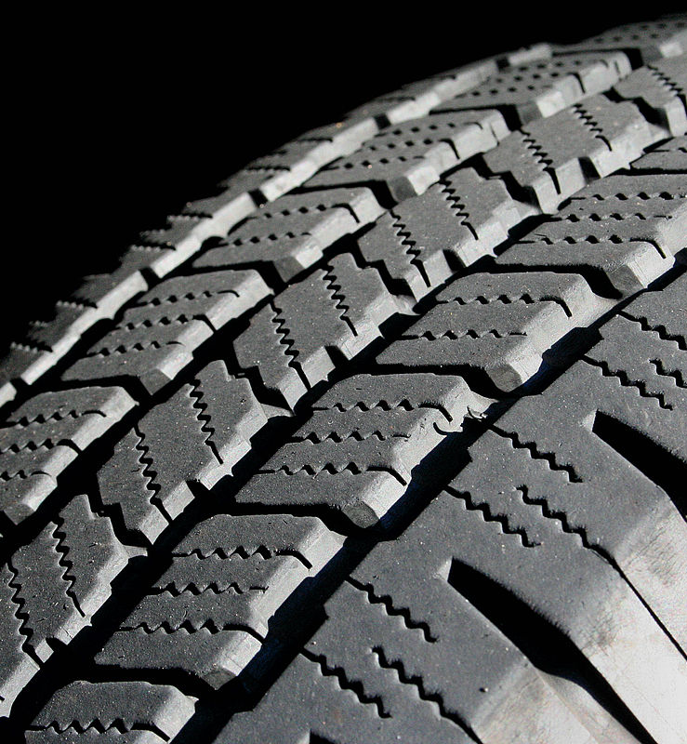
Friction and Traction
Many people believe their steering wheel, brake pedal, and accelerator control their vehicle. Your four tires, and their footprints that touch the road, are the first and one of the most important parts to the control system.

Slide 6
Is the force that keeps each tire from sliding on the road.
The friction created by the tire on the road is called Traction.
Friction:
Traction:

Slide 7
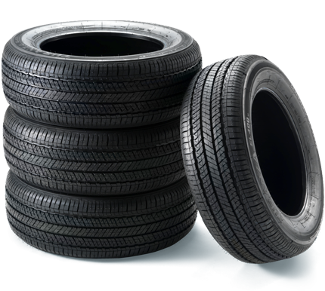
Tires
Tires make a difference in the way your vehicle performs. The simple mistake of driving with low pressure in your tires can mean the difference between avoiding a collision or hitting something.

Slide 8
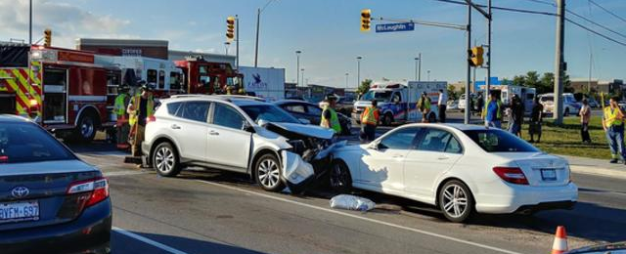
Controlling Force of Impact
Collisions can be violent. If you have ever seen a sever traffic collision, you know that collisions happen with blinding speed usually in less time than it takes to blink your eye.

Slide 9
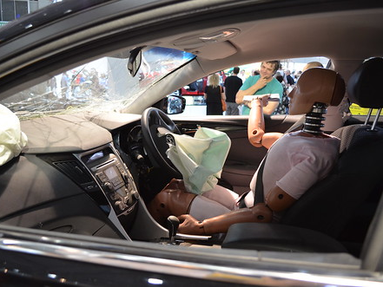
Force of Impact
In a violent collision, vehicle occupants need all the protection they can get. If they are not protected, they will be thrown against the vehicle’s interior in a second collision or ejected from the vehicle..
The force with which a moving object hits another object is called force of impact.

Slide 10
Three factors determine how hard something will hit another object:
Speed
Weight
Distance between impact and stopping.

Slide 11
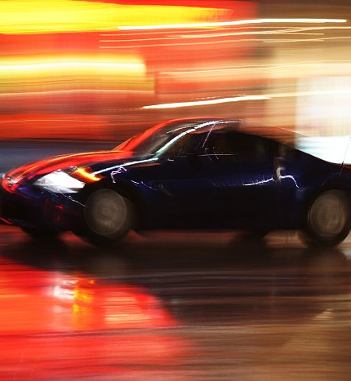
Speed:
Speed is the most important factor in determining how hard a vehicle will hit another object.
Weight:
The heavier a vehicle, the more damage it will cause in a collision. A vehicle weighing twice as much as another vehicle will hit a solid object twice as hard.
Distance Between Impact and Stopping:
The distance a vehicle covers between the instant it hits an object and the moment it comes to a stop can vary greatly.

Slide 12
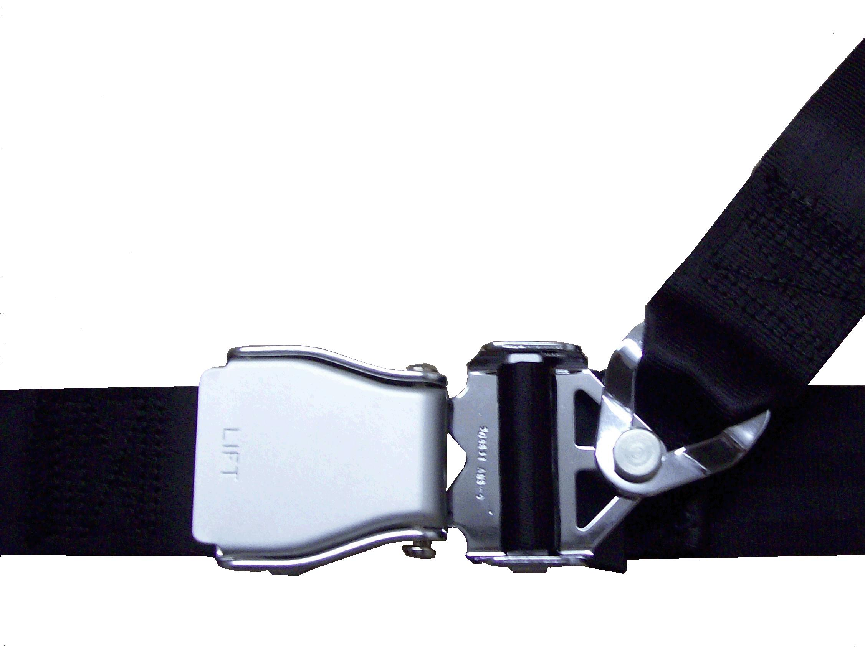
Safety Belts:
Three collisions occur when a vehicle hits a solid object.
First, the vehicle hits the object and stops.
Second, the occupants either hit the inside of the vehicle or their restraint devices.
Third, occupants may suffer internal collisions as their organs impact inside their bodies.

Slide 13
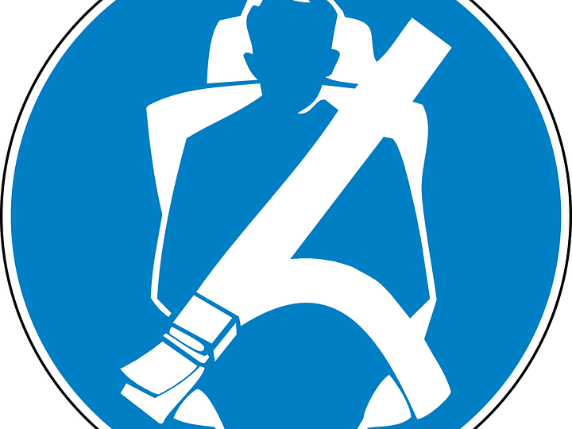
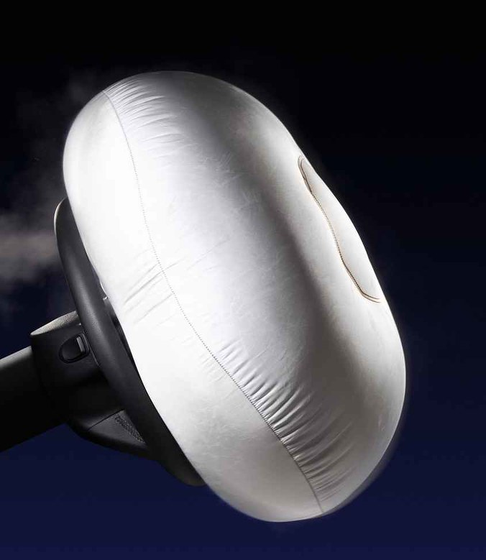
Restraint Devices
A restraint device is any part of a vehicle that holds an occupant in a crash.
A passive restraint device such as an air bag, is a part that work automatically.
A device you must engage, like a safety belt, is called an active restraint device.

Slide 14
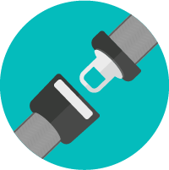
How to Wear Safety Belts
What can you do ahead of time to reduce the possibility of serious injury?
Using a safety belt is your number one defense. Safety belts will hold you in place during an emergency and prevent you from being thrown from your vehicle. Any time you are in a vehicle you need to follow these steps for wearing your safety belt.

Slide 15
Fact:
4 out of 10 teen boys don’t wear seat belts
Fact:
3 out of 10 teen girls don’t wear seat belts
87% of fatal teen crashes, teens are not wearing seat belts
Adjust your seat to comfortable upright position. Make sure your safety belt is not twisted
Snap the metal fitting on the end of the safety belt into the buckle. Then adjust the lap part of your safety belt so that it is low and snug across your hips. The bottom edge of the safety belt should just touch your thighs. By making this adjustment, any crash forces will be applied to your pelvic bones.
Adjust the shoulder part of your safety belt across your chest. Your shoulder belt should be snug.

